Slide 1
Introductory Statistics
Tenth Edition
Prem Mann
Chapter 1
Introduction
This slide deck contains animations. Please disable animations if they cause issues with your device.
Copyright ©2021 John Wiley & Sons, Inc.

Slide 2
Opening Example
What are the opinions of teens ages 13 to 17 years about the anxiety and depression among teens living in their community? Do they think it is a major problem? Or is it a minor problem? Or is it not a problem? A survey conducted by the Pew Research Center in 2018 found that 70% of such teens said that anxiety and depression is a major problem among teens in the community where they live, 26% said it is a minor problem, and 4% said it is not a problem. (See Case Study 1.2.)

Slide 3
1.1 Statistics and Types of Statistics
Definition
Statistics is the science of collecting, analyzing, presenting, and interpreting data, as well as of making decisions based on such analyses.

Slide 4
Types of Statistics: Descriptive Statistics
Definition
Descriptive Statistics consists of methods for organizing, displaying, and describing data by using tables, graphs, and summary measures.

Slide 5
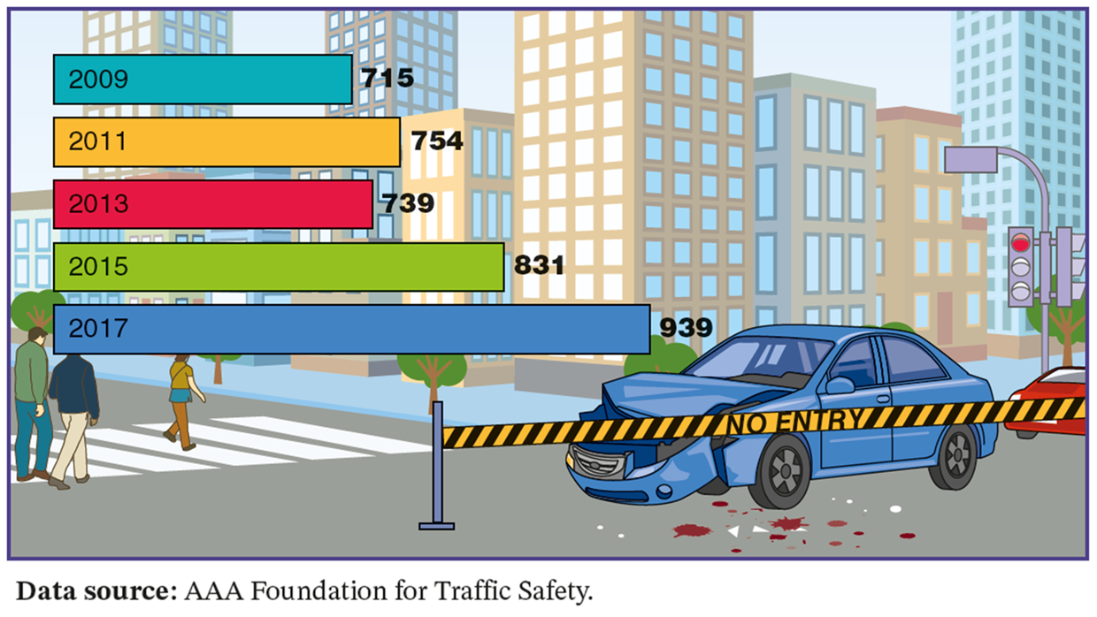
Case Study 1-1 Deaths Due to Red-Light Running
Data source: AAA Foundation for Traffic Safety.

Slide 6
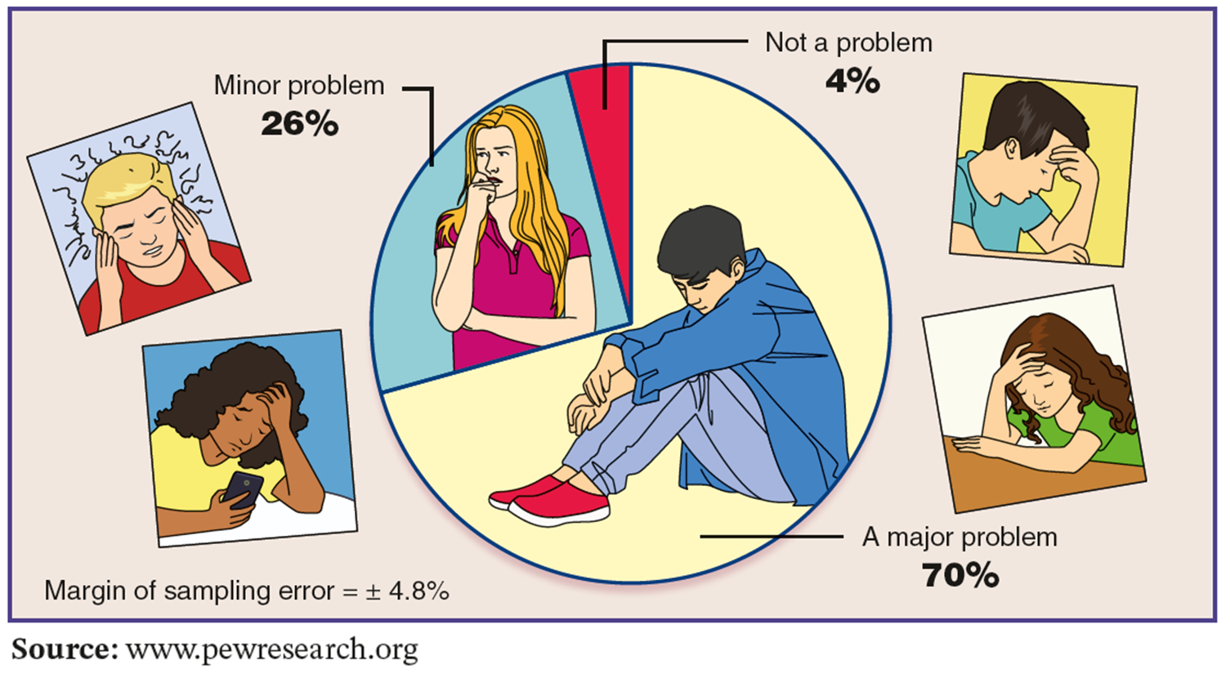
Case Study 1-2 Is Anxiety and Depression a Major Problem Among Teens?
Source: www.pewresearch.org

Slide 7
Types of Statistics: Inferential Statistics
Definition
Inferential Statistics consists of methods that use sample results to help make decisions or predictions about a population.

Slide 8
1.2 Basic Terms
Definition
An element or member of a sample or population is a specific subject or object (for example, a person, firm, item, state, or country) about which the information is collected.

Slide 9
Basic Terms (1 of 2)
Definition
A variable is a characteristic under study that assumes different values for different elements. In contrast to a variable, the value of a constant is fixed.

Slide 10
Basic Terms (2 of 2)
Definition
The value of a variable for an element is called an observation or measurement.
A data set is a collection of observations on one or more variables.

Slide 11
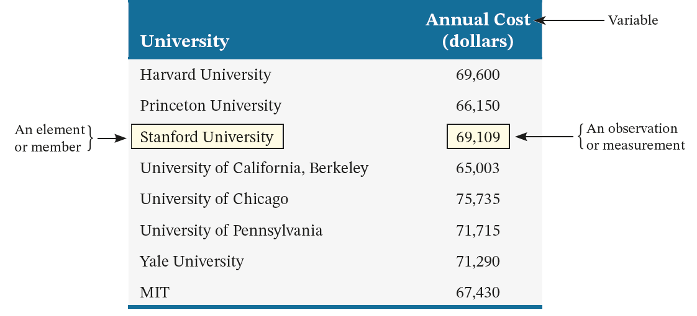
Table 1.1 Annual Costs of Attending Eight American Universities

Slide 12
1.3 Types of Variables
Quantitative Variables
Discrete Variables
Continuous Variables
Qualitative or Categorical Variables

Slide 13
Quantitative Variables
Definition
A variable that can be measured numerically is called a quantitative variable. The data collected on a quantitative variable are called quantitative data.

Slide 14
Quantitative Variables: Discrete
Definition
A variable whose values are countable is called a discrete variable. In other words, a discrete variable can assume only certain values with no intermediate values.

Slide 15
Quantitative Variables: Continuous
Definition
A variable that can assume any numerical value over a certain interval or intervals is called a continuous variable.

Slide 16
Qualitative or Categorical Variable
Definition
A variable that cannot assume a numerical value but can be classified into two or more nonnumeric categories is called a qualitative or categorical variable. The data collected on such a variable are called qualitative data.

Slide 17
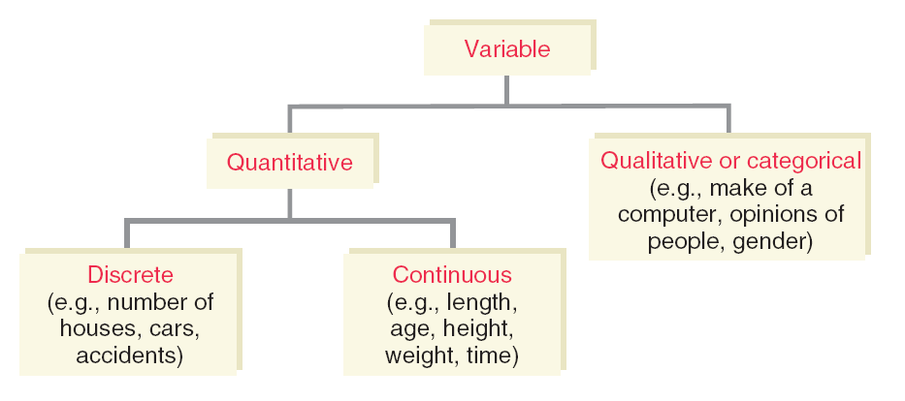
Figure 1.1 Types of Variables

Slide 18
1.4 Cross-Section Versus Time-Series Data
Cross-Section Data
Time-Series Data

Slide 19
Cross-Section Data
Definition
Data collected on different elements at the same point in time or for the same period of time are called cross-section data.

Slide 20
Table 1.2 Annual Costs of Attending Eight American Universities
University | Annual Cost (dollars)
Harvard University | 69,600
Princeton University | 66,150
Stanford University | 69,109
University of California, Berkeley | 65,003
University of Chicago | 75,735
University of Pennsylvania | 71,715
Yale University | 71,290
MIT | 67,430
Source: Forbes, September 30, 2018.

Slide 21
Time-Series Data
Definition
Data collected on the same element for the same variable at different points in time or for different periods of time are called time-series data.

Slide 22
Table 1.3 Total Population of the United States
Years | Total Population
2015 | 320,878,310
2016 | 323,015,995
2017 | 325,084,756
2018 | 327,096,265
2019 | 329,064,917
Source: www.worldometers.info

Slide 23
1.5 Population Versus Sample
Definition
A population consists of all elements – individuals, items, or objects – whose characteristics are being studied. The population that is being studied is also called the target population.
A portion of the population selected for study is referred to as a sample.

Slide 24
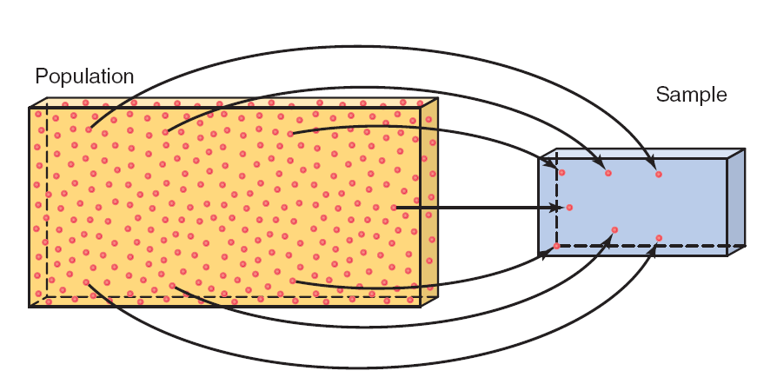
Figure 1.2 Population and Sample

Slide 25
Population Versus Sample
Definition
A survey that includes every member of the population is called a census. The technique of collecting information from a portion of the population is called a sample survey.

Slide 26
Representative Sample
Definition
A sample that represents the characteristics of the population as closely as possible is called a representative sample.

Slide 27
Random Sample Versus Non-Random Sample
Definition
A random sample is a sample drawn in such a way that each member of the population has some chance of being selected. In a non-random sample, some members of the population may not have any chance of being selected in the sample.

Slide 28
Sampling Error Versus Nonsampling Error
Definition
The sampling error is the difference between the result obtained from a sample survey and the result that would have been obtained if the whole population had been included in the survey.
The errors that occur in the collection, recording, and tabulation of data are called nonsampling errors or biases.

Slide 29
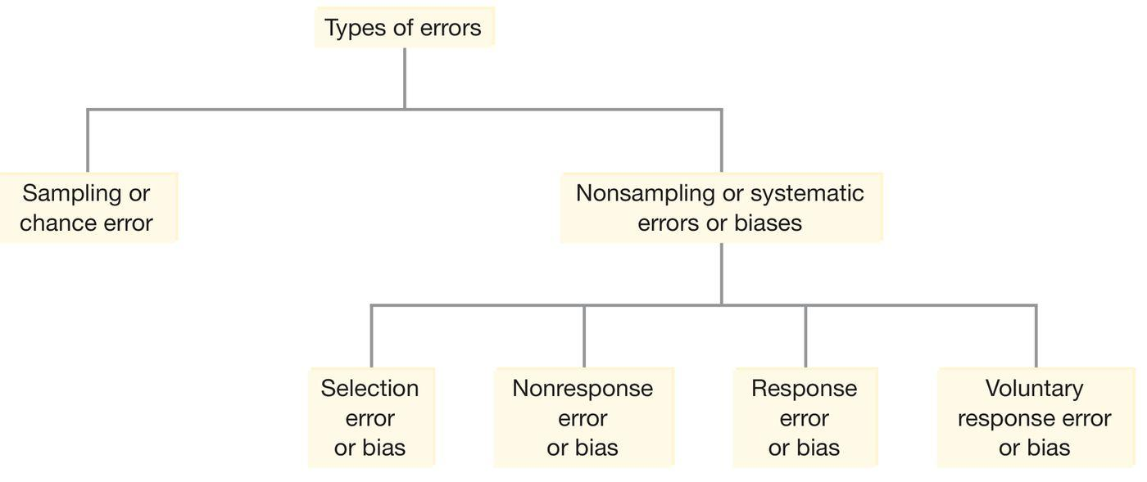
Figure 1.3 Types of Errors

Slide 30
Selection Error Versus Nonresponse Error
Definition
The list of members of the target population that is used to select a sample is called the sampling frame. The error that occurs because the sampling frame is not representative of the population is called the selection error or biases.
The error that occurs because many of the people included in the sample do not respond to a survey is called the nonresponse error or biases.

Slide 31
Response Error Versus Voluntary Response Error
Definition
The response error or biases occurs when people included in the survey do not provide correct answers.
Voluntary response error or biases occurs when a survey is not conducted on a randomly selected sample but on a questionnaire published in a magazine or newspaper and people are invited to respond to that questionnaire.

Slide 32
Random Sampling Techniques (1 of 2)
Definition
In this sampling technique, each sample of the same size has the same probability of being selected. Such a sample is called a simple random sample.
In systematic random sampling, we first randomly select one member from the first k units of the list of elements arranged based on a given characteristic where k is the number obtained by dividing the population size by the intended sample size. Then every kth member, starting with the first selected member, is included in the sample.

Slide 33
Random Sampling Techniques (2 of 2)
Definition
In stratified random sample, we first divide the population into subpopulations, which are called strata. Then, one sample is selected from each of these strata. The collection of all samples from all strata gives the stratified random sample.
In cluster sampling, the whole population is first divided into (geographical) groups called clusters. Each cluster is representative of the population. Then a random sample of clusters is selected. Finally, a random sample of elements from each of the selected clusters is selected.

Slide 34
1.6 Design of Experiments
Definition
A condition (or a set of conditions) that is imposed on a group of elements by the experimenter is called a treatment.
The procedure in which elements are assigned to different groups at random is called randomization.

Slide 35
Designed Experiment Versus Observational Study
Definition
When the experimenter controls the (random) assignment of elements to different treatment groups, the study is said to be a designed experiment. In contrast, in an observational study the assignment of elements to different treatments is voluntary, and the experimenter simply observes the results of the study.

Slide 36
Treatment Group Versus Control Group
Definition
The group of elements that receives a treatment is called the treatment group, and the group of elements that does not receive a treatment is called the control group.

Slide 37
Example 1-1
Suppose a pharmaceutical company has developed a new medicine to cure a disease. To see whether or not this medicine is effective in curing this disease, it will have to be tested on a group of humans. Suppose there are 100 persons who have this disease; 50 of them voluntarily decide to take this medicine, and the remaining 50 decide not to take it. The researcher then compares the cure rates for the two groups of patients. Is this an example of a designed experiment or an observational study?

Slide 38
Example 1-1: Solution
This is an example of an observational study because 50 patients voluntarily joined the treatment group; they were not randomly selected.
In this case, the results of the study may not be valid because the effects of the medicine will be confounded with other variables. All of the patients who decided to take the medicine may not be similar to the ones who decided not to take it. It is possible that the persons who decided to take the medicine are in the advanced stages of the disease. Consequently, they do not have much to lose by being in the treatment group. The patients in the two groups may also differ with regard to other factors such as age, gender, and so on.

Slide 39
Example 1-2
Reconsider Example 1–1. Now, suppose that out of the 100 people who have this disease, 50 are selected at random. These 50 people make up one group, and the remaining 50 belong to the second group. One of these groups is the treatment group, and the second is the control group. The researcher then compares the cure rates for the two groups of patients. Is this an example of a designed experiment or an observational study?

Slide 40
Example 1-2: Solution
In this case, the two groups are expected to be very similar to each other. Note that we do not expect the two groups to be exactly identical. However, when randomization is used, the two groups are expected to be very similar. After these two groups have been formed, one group will be given the actual medicine. This group is called the treatment group. The other group will be administered a placebo (a dummy medicine that looks exactly like the actual medicine). This group is called the control group.
This is an example of a designed experiment because the patients are assigned to one of two groups—the treatment or the control group—randomly.

Slide 41
1.7 Summation Notation
Suppose a sample consists of five books, and the prices of these five books are
$175, $80, $165, $97, and $88
The variable price of a book: x
Price of the first book = x₁ = $175
Price of the second book = x₂ = $80
Price of the third book = x₃ = $165
Price of the fourth book = x₄ = $97
Price of the fifth book = x₅ = $88

Slide 42
Summation Notation
Adding the prices of all five books gives
x₁+x₂+x₃+x₄+x₅ = 175+80+165+97+88 = $605
Σx = x₁+x₂+x₃+x₄+x₅ = $605

Slide 43
Example 1-3
Annual salaries (in thousands of dollars) of four workers are 75, 90, 125, and 61, respectively. Find
∑x
(∑x)²
∑x²

Slide 44
Example 1-3: Solution (1 of 2)
∑x = x₁ + x₂ + x₃ + x₄
= 75 + 90 + 125 + 61
= 351 = $351,000
Note that (∑x)² is the square of the sum of all x values.
Thus,
(∑x)² = (351)² = 123,201

Slide 45
Example 1-3: Solution (2 of 2)
The expression ∑x² is the sum of the squares of x values.
To calculate ∑x² , we first square each of the x values and then sum these squared values. Thus,
∑x² = (75)² + (90)² + (125)² + (61)²
= 5,625 + 8,100 + 15,625 + 3,721
= 33,071

Slide 46
Example 1-4
The following table lists four pairs of m and f values:
m | 12 | 15 | 20 | 30
f | 5 | 9 | 10 | 16
Compute the following:
Σm
Σf²
Σmf
Σm²f

Slide 47
Example 1-4: Solution
We can write
m₁ = 12 m₂ = 15 m₃ = 20 m₄ = 30
f₁ = 5 f₂ = 9 f₃ = 10 f₄ = 16
m | f | f ² | m f | m² f
12 | 5 | 5 × 5 = 25 | 12 × 5 = 60 | 12 × 12 × 5 = 720
15 | 9 | 9 × 9 = 81 | 15 × 9 = 135 | 15 × 15 × 9 = 2025
20 | 10 | 10 × 10 = 100 | 20 × 10 = 200 | 20 × 20 × 10 = 4000
30 | 16 | 16 × 16 = 256 | 30 × 16 = 480 | 30 × 30 × 16 = 14,400
Σm = 77 | Σf = 40 | Σf² = 462 | Σmf = 875 | Σm₂f = 21,145
(a) (b) (c) (d)

Slide 48
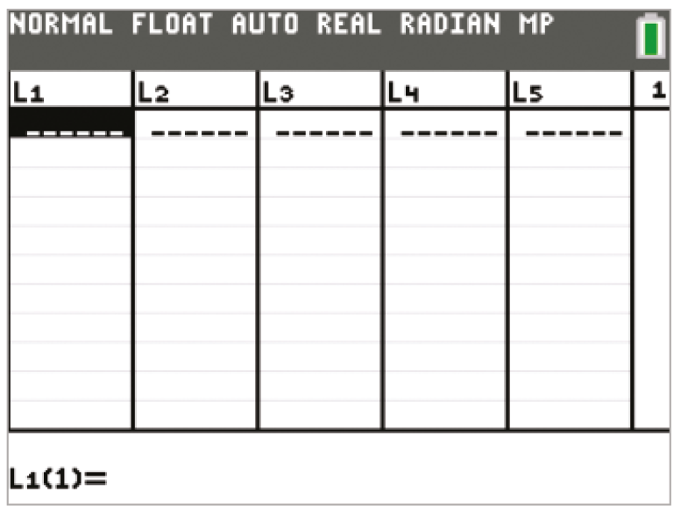
TI-84 Color/TI-84 (1 of 8)

Slide 49
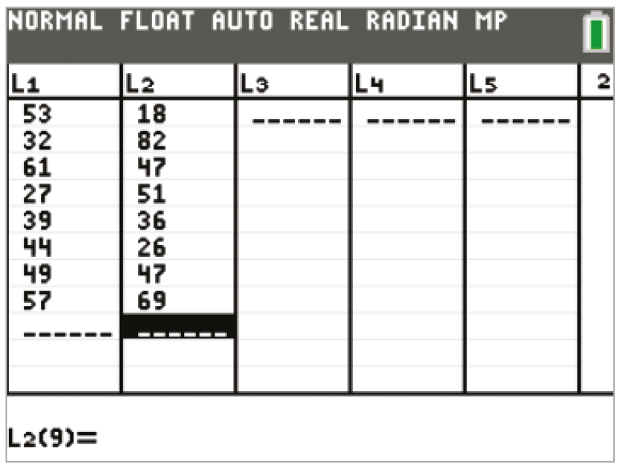
TI-84 Color/TI-84 (2 of 8)

Slide 50
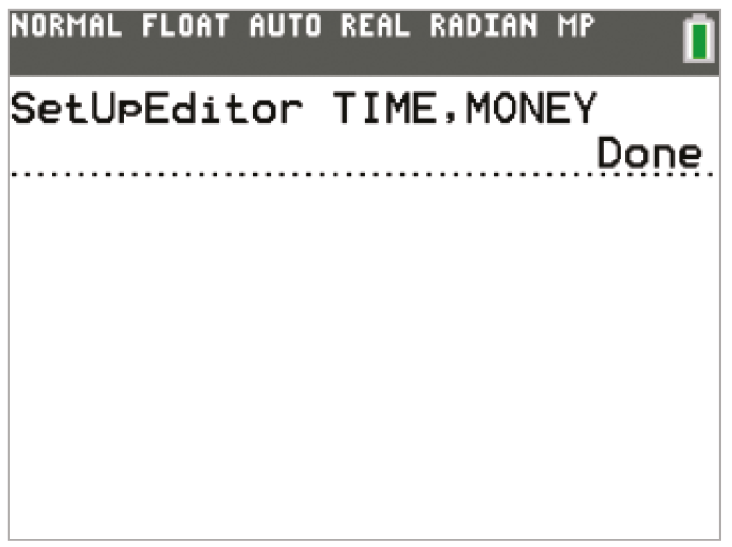
TI-84 Color/TI-84 (3 of 8)

Slide 51
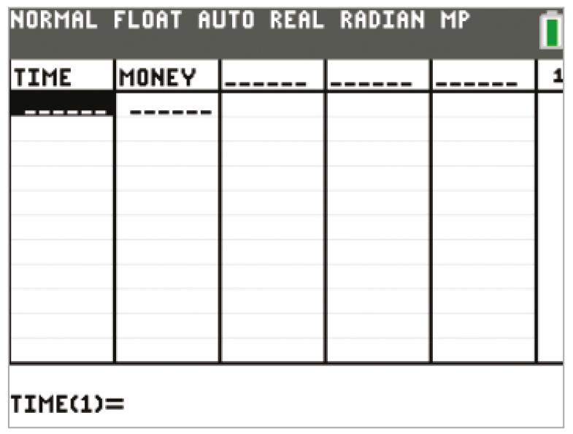
TI-84 Color/TI-84 (4 of 8)

Slide 52
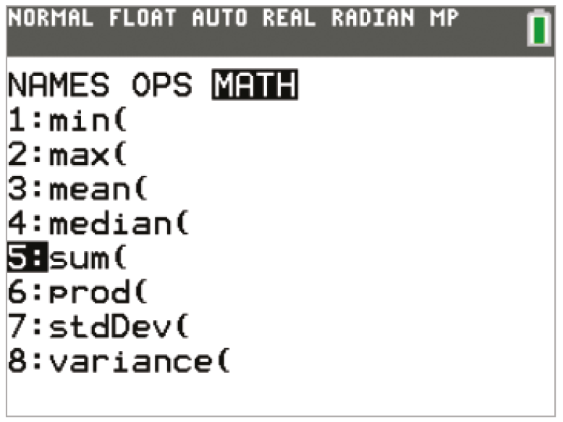
TI-84 Color/TI-84 (5 of 8)

Slide 53
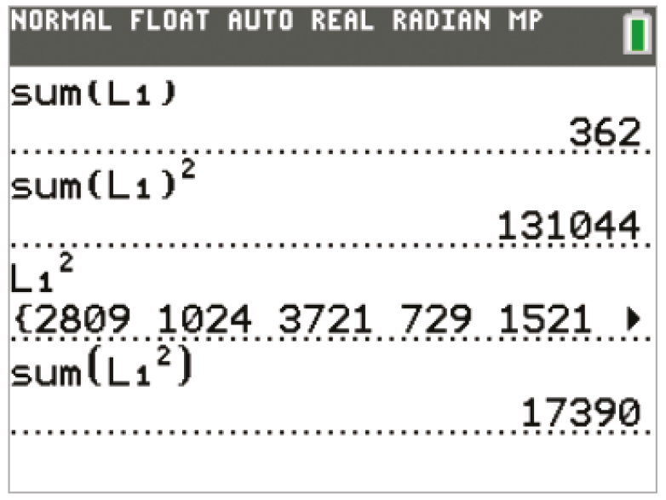
TI-84 Color/TI-84 (6 of 8)

Slide 54
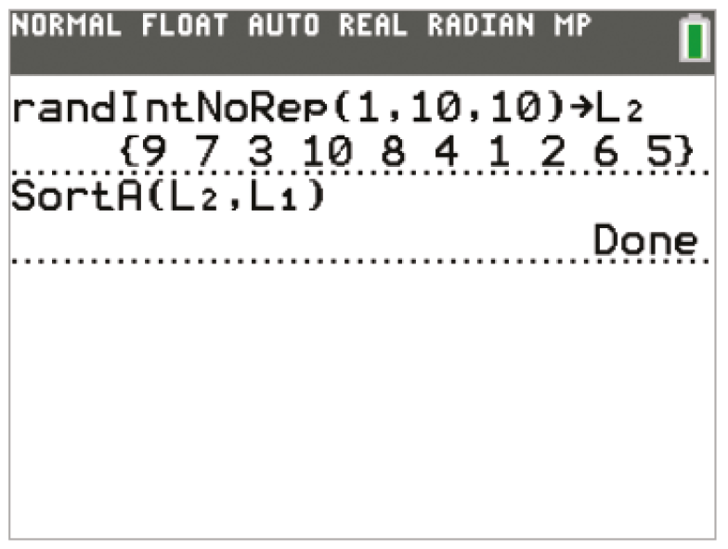
TI-84 Color/TI-84 (7 of 8)

Slide 55
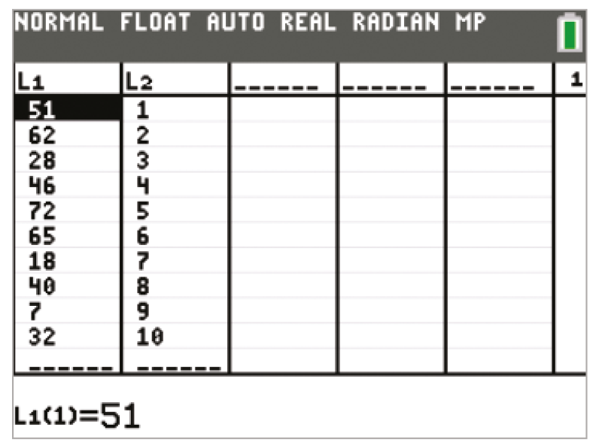
TI-84 Color/TI-84 (8 of 8)

Slide 56
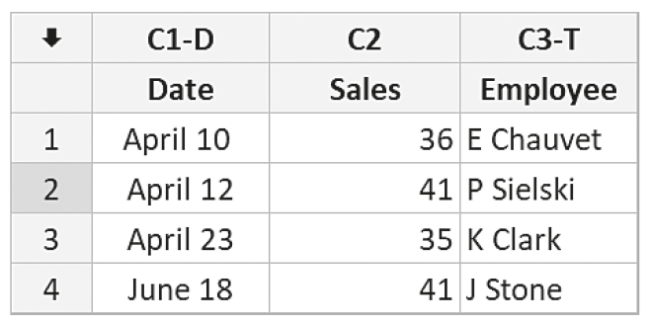
Minitab (1 of 5)

Slide 57
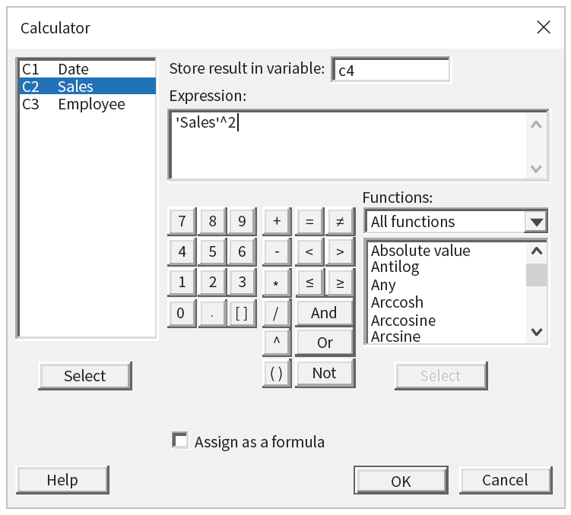
Minitab (2 of 5)

Slide 58
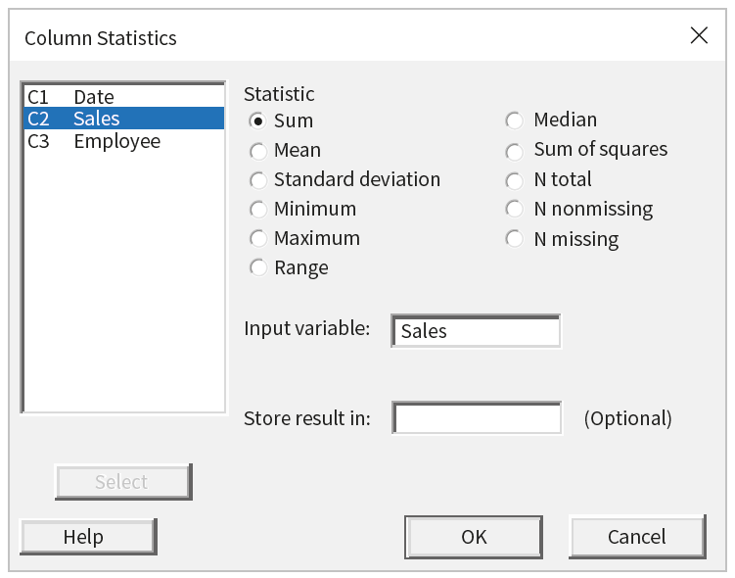
Minitab (3 of 5)

Slide 59
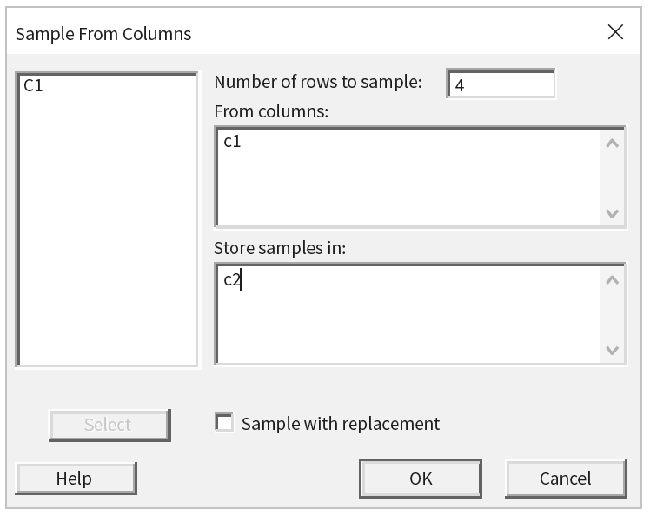
Minitab (4 of 5)

Slide 60
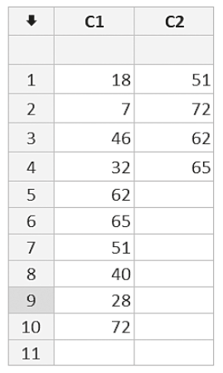
Minitab (5 of 5)

Slide 61
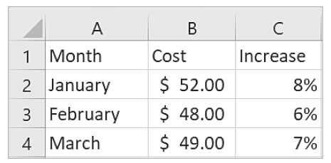
Excel (1 of 4)

Slide 62
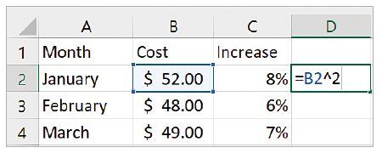
Excel (2 of 4)

Slide 63
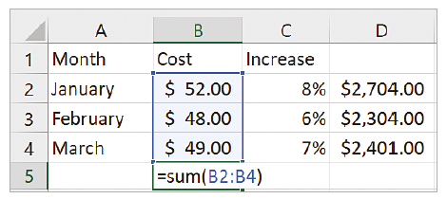
Excel (3 of 4)

Slide 64
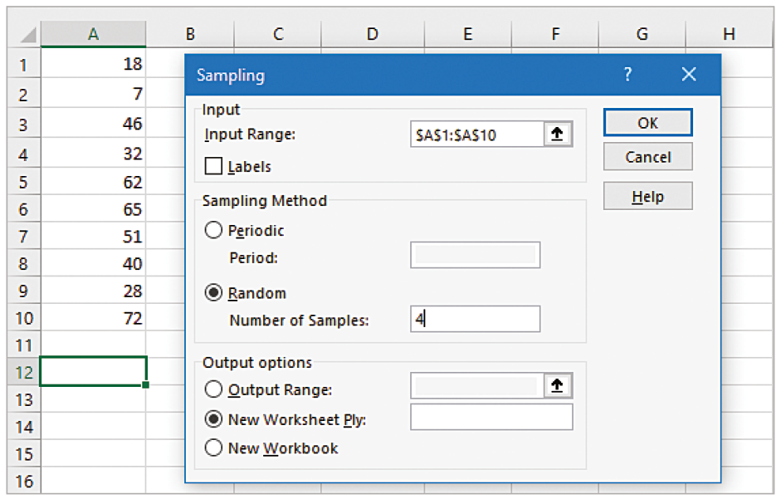
Excel (4 of 4)

Slide 65
Copyright
Copyright © 2021 John Wiley & Sons, Inc.
All rights reserved. Reproduction or translation of this work beyond that permitted in Section 117 of the 1976 United States Act without the express written permission of the copyright owner is unlawful. Request for further information should be addressed to the Permissions Department, John Wiley & Sons, Inc. The purchaser may make back-up copies for his/her own use only and not for distribution or resale. The Publisher assumes no responsibility for errors, omissions, or damages, caused by the use of these programs or from the use of the information contained herein.

